Slide 1
Cytoflex Cytometer
Training April 25, 2018

Slide 2
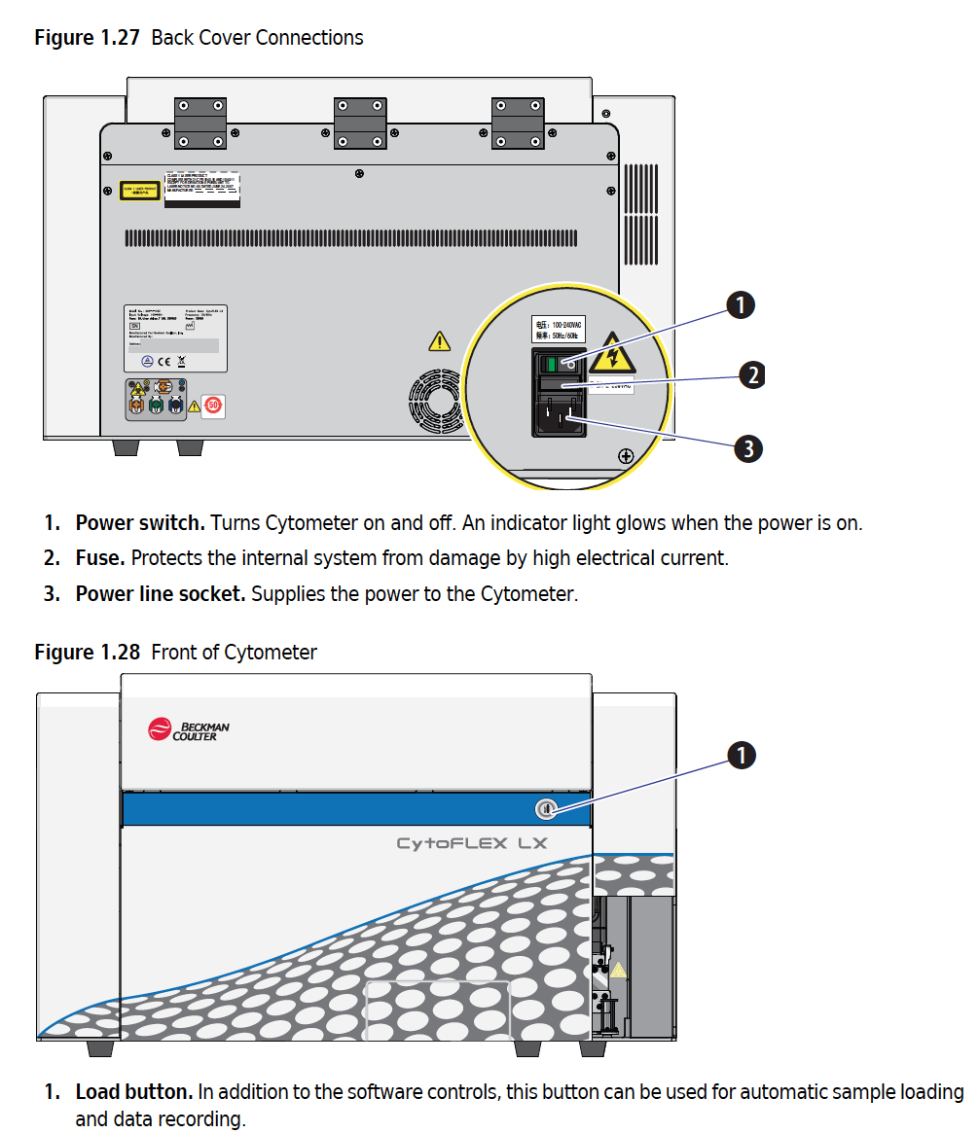
Cytoflex Cytometer

Slide 3
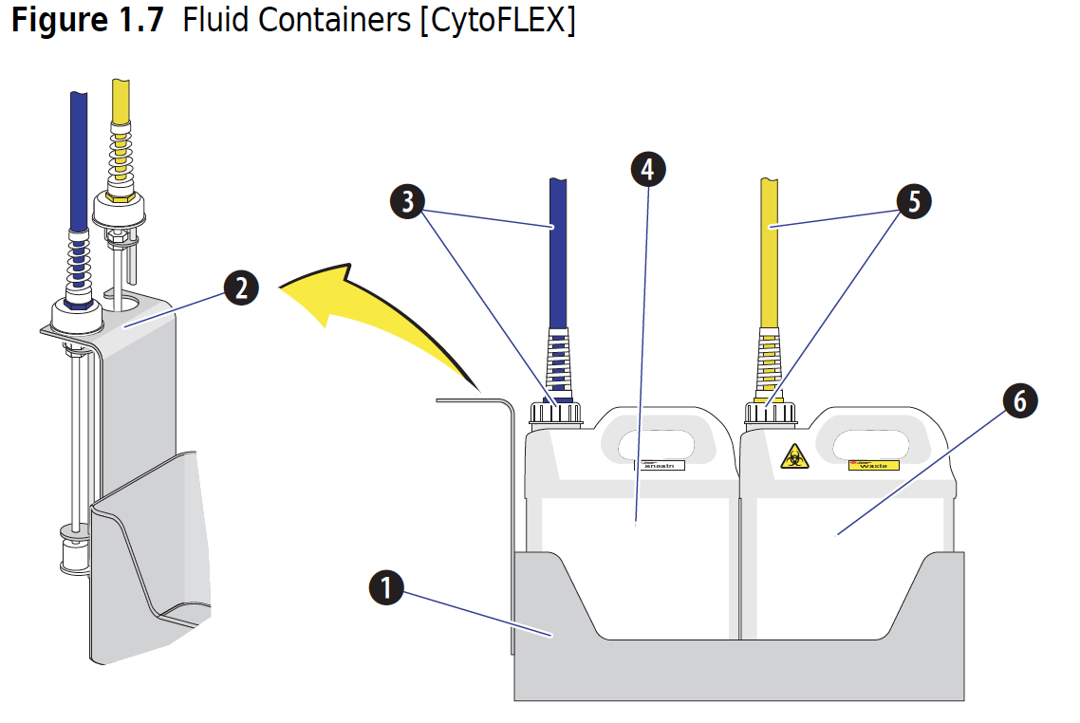
Before Startup – Check Fluidics

Slide 4
Cytoflex – Power Switch

Slide 5
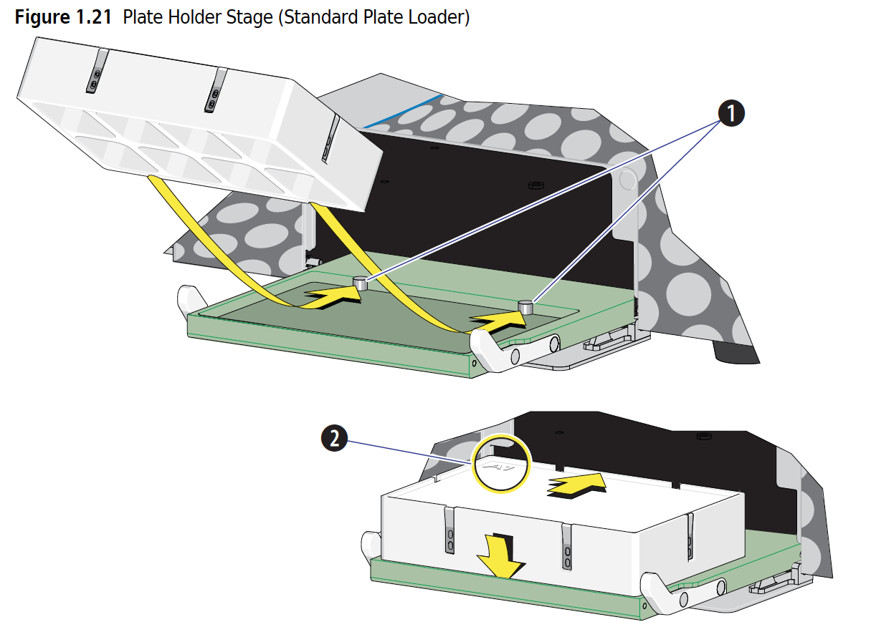
Cytoflex – Sample Types
FACS Tubes
96-well Plates

Slide 6
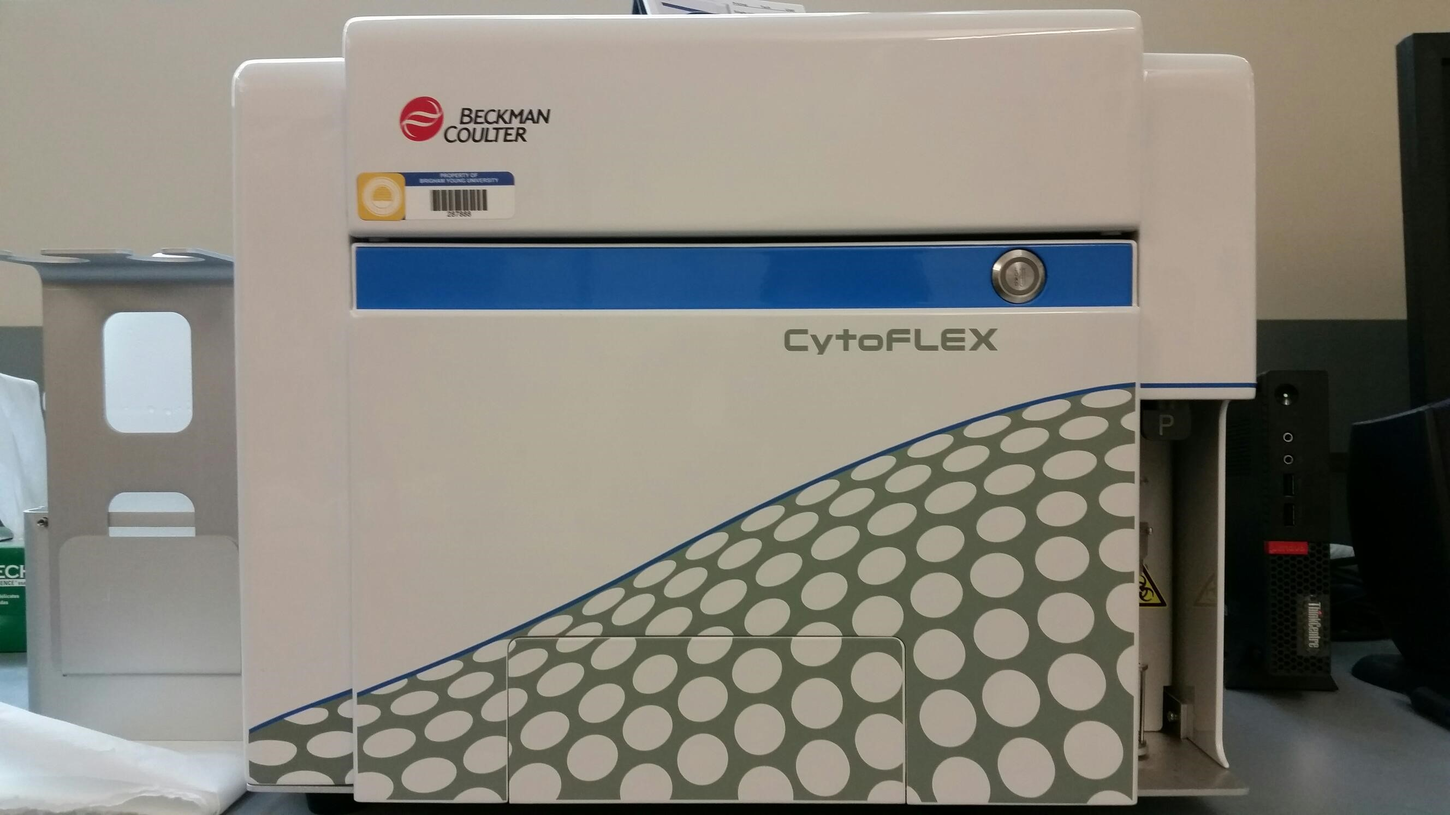
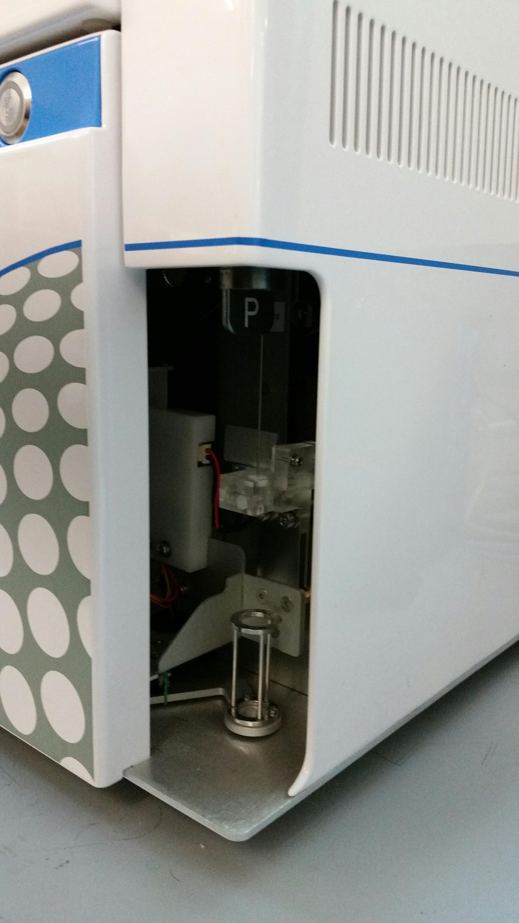
Cytoflex – Sample Types
FACS Tubes
96-well Plates

Slide 7
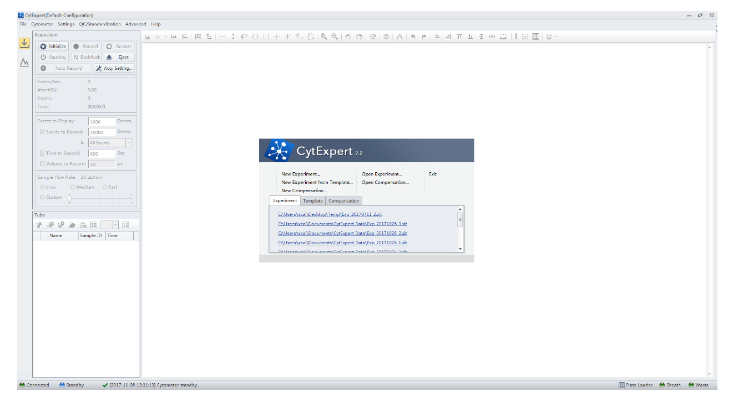
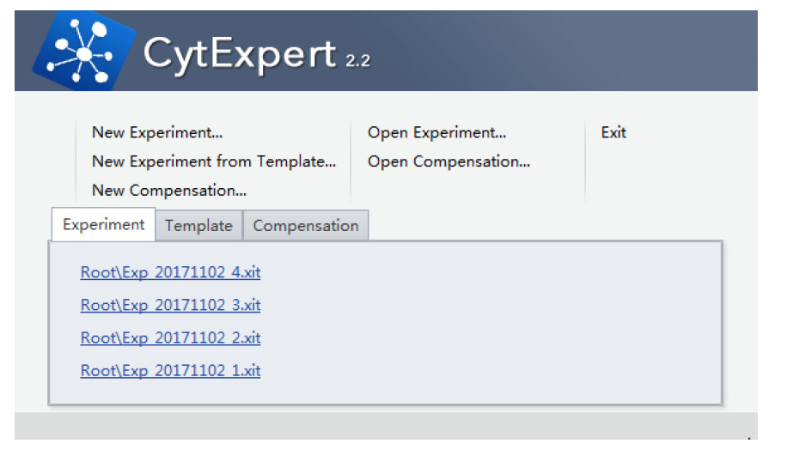
Start Up – Sign In & Choose

Slide 8
Start Up – Choose method
Tubes

Slide 9
Start Up – Run Startup (~8 minutes)

Slide 10
Tubes Plates
Select Plate type
Set a Tube in place
Fill Wells

Slide 11
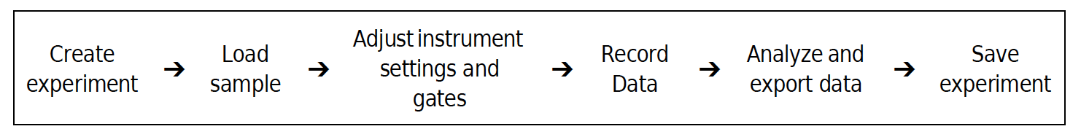
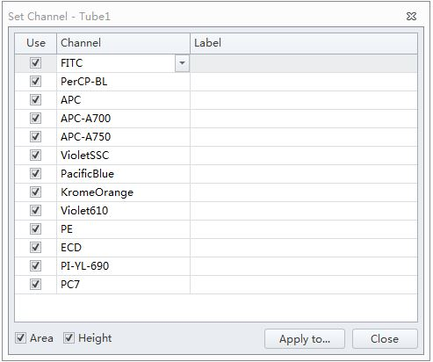
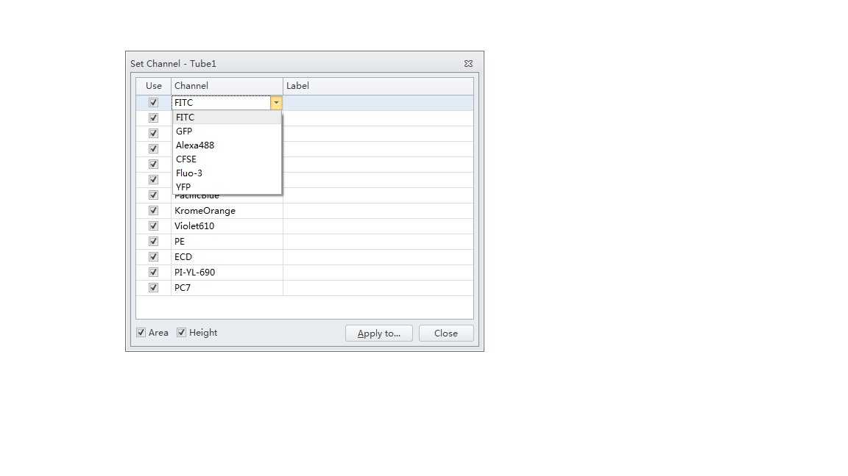
Run Samples – Choose Detectors
Select Channels to record
Label your Dye

Slide 12
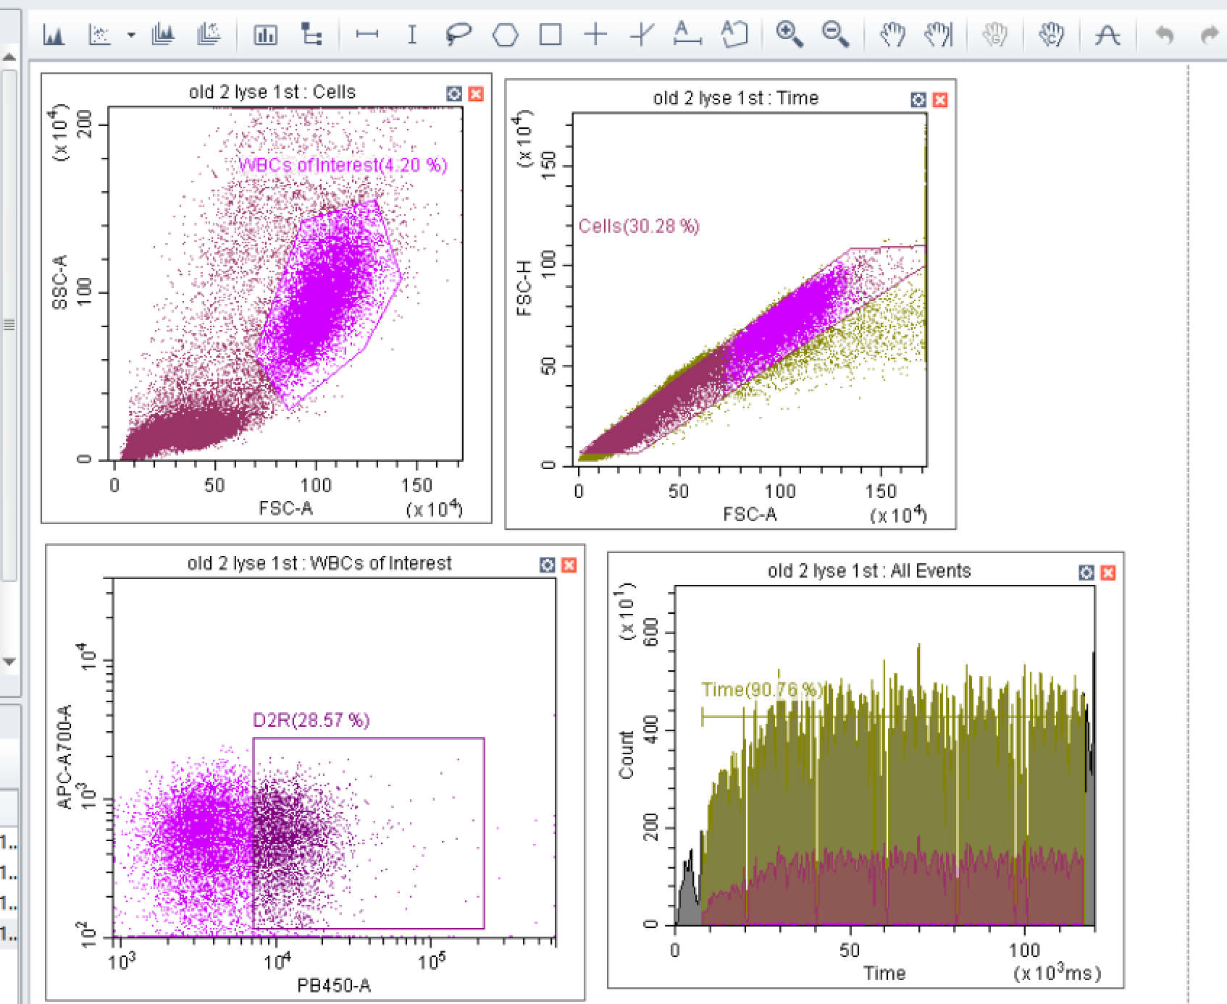
Setup Plots
Always setup FSCxSSC
Useful to setup singlet gate
FSC-A x FSC-H
Always Setup TIME
histogram
*Setup gates after or during collection.

Slide 13
Setup Plots
Always setup FSCxSSC
Useful to setup singlet gate
FSC-A x FSC-H
TIME:
View Peristaltic pump
Watch for Clogs
Gate “good” reads
Always Setup TIME
histogram

Slide 14
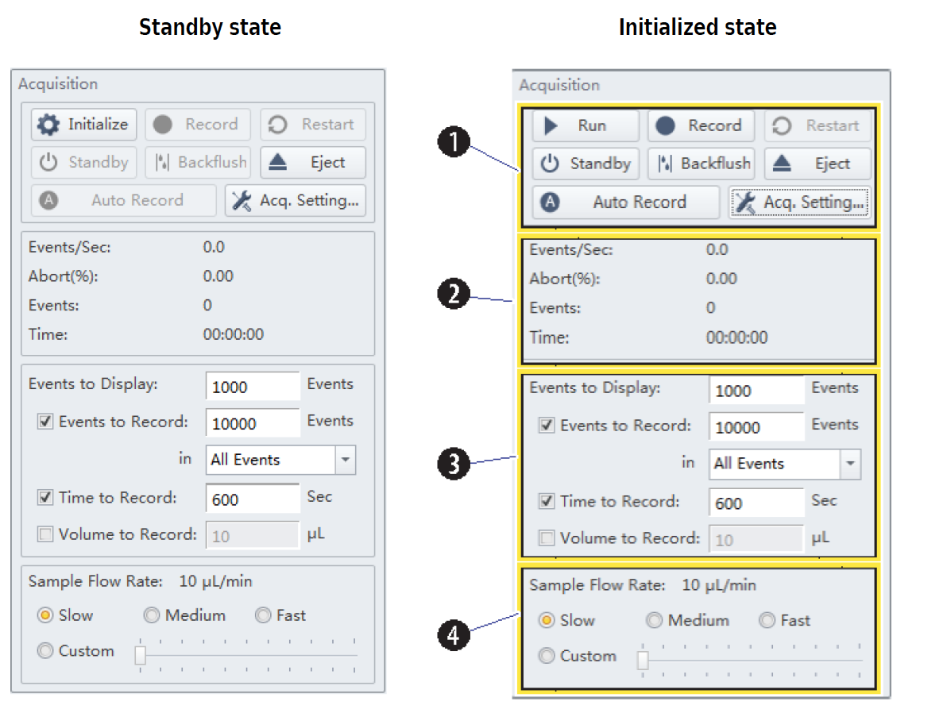
Acquisition Settings
Gains
Always begin with Recommended Gains

Slide 15
Acquisition Settings
Threshold
Default is Automatic
You may need Manual

Slide 16
Acquisition Settings – Control Panel

Slide 17
Acquisition Settings – Control Panel
The default is pretty low
Choose
Begin Slow, speed up as needed

Slide 18
Acquisition Settings – Control Panel
Initialize
Run
1. Set threshold
2. Set gains
3. Record

Slide 19
Getting Counts
Finding your population
Watch:
Events per second (1000-10,000)
Abort rate (>5)
Check:
Events displayed
Total events
Zoom/pan
Check:
Threshold
Sample Flow Rate
Sample concentration
Zoom
Pan
at least 1000
low
hopefully a lot
5K
Should you run it faster? Should you bring more concentrated samples next time?
Threshold is set

Slide 20
Practice files:
We will practice the following skills:
1. Finding populations (use zoom & pan)
2. Setup plots
3. Setup and move gates, navigate between samples
4. Setup hierarchy table, statistics
5. Export files
6. Make a compensation matrix

Slide 21
Cytometer – Flush (~10 minutes)
Run Daily Clean:
Prepare solutions:
Two Tubes:
2 ml FlowClean (blue)
3 ml DI water (sheath)
After cleaning, put it on Standby. Do not turn off machine
96-well plate:
3 wells of FlowClean
5 wells of DI Water
At least 250 ul per well.
Clean 1st

Slide 22
Cytometer – Flush (~12 minutes)
Follow On-Screen Instructions
3 minutes
Blue FlowClean
Tubes
Plates
3 Wells
Blue FlowClean
5 minutes
DI water
5 Wells
DI water

Slide 23
Cytometer – Full Shutdown (~25 minutes)
Run Daily Clean:
Prepare solutions:
Two Tubes:
2 ml FlowClean (blue)
3 ml DI water (sheath)
After cleaning, put it on Standby before turning off the power.
96-well plate:
3 wells of FlowClean
5 wells of DI Water
At least 250 ul per well.
Clean 1st

Slide 24
Cytometer – Full Shutdown
Follow On-Screen Instructions
10 minutes
Blue FlowClean
Tubes
Plates
3 Wells
Blue FlowClean
15 minutes
DI water
5 Wells
DI water
After: Select “Standby”. Turn off the Cytometer. Logoff the computer.

Slide 25
Laser | Fluorescent Channel | Channel Names/Dyes
488 nm - Blue | 525/40 | BL1, FITC, GFP, Alexa-488, CFSE, Fluo-3, YFP
 | 690/50 | BL2, PerCP, PI, PC5, PC5.5, PerCP-Cy5.5
 | 488/8 | Blue SSC
 | FSC | FSC
638 nm - Red | 780/60 | RL3, APC-H7, APC-A750, APC-Cy7, APC-eFluor780
 | 712/25 | RL2, APC-A700, Alexa-700
 | 660/20 | RL1, APC, Alexa-647, eFluor-660
561 nm - Yellow | 610/20 | YL2, ECD, mCherry, PI, PE-Texas Red, PE-CF594
 | 585/42 | YL1, PE, PI, dTomato, DsRed
 | 690/50 | YL3, PerCP, PI, PC5.5, PerCP-Cy5.5, PC5
 | 780/60 | YL4, PC7, PE-Cy7
405 nm- Violet | 405/10 | Violet SSC (nanoparticle)
 | 450/45 | VL1, Pacific Blue, Brilliant Violet 421, CFP, eFluor-450, V450
 | 525/40 | VL2, CFP-YFP, Krome Orange, AmCyan, V500, Brilliant Violet 510
 | 610/20 | VL3, mCherry, Brilliant Violet 605, Violet 610, Qdot 605
 | Other optional Filters | Optional Colors
 | 780/60 | For Violet laser
 | 660/20 | Brilliant Violet 650, Qdot 655
 | 561/10 | FSC, SSC for yellow laser

Slide 26
JUNK SLIDES

Slide 27
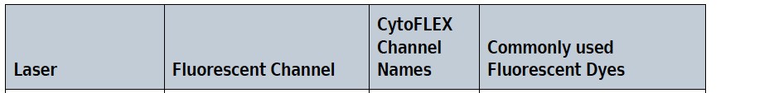
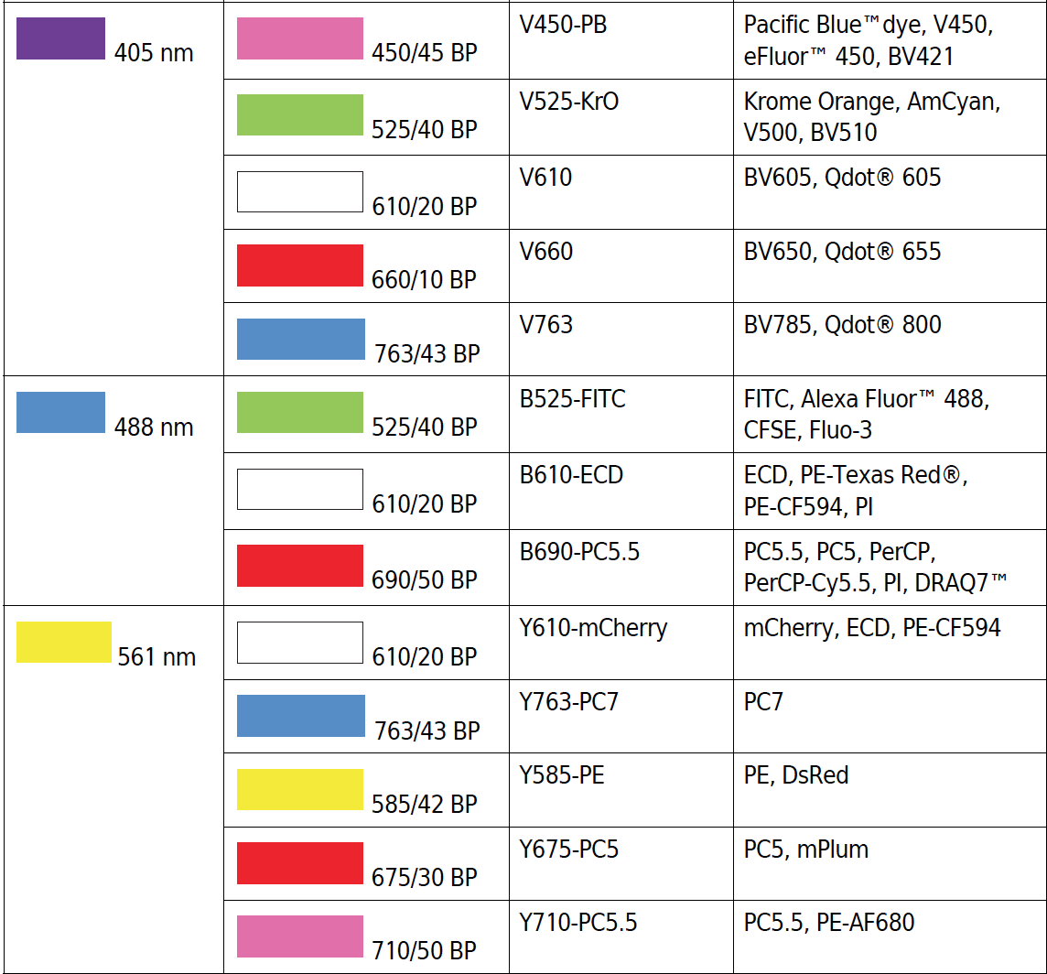
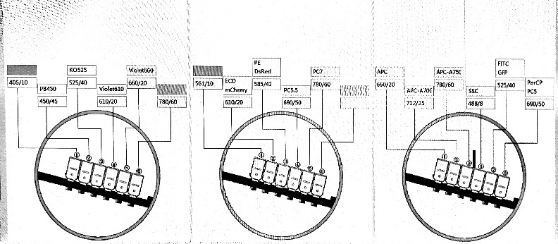
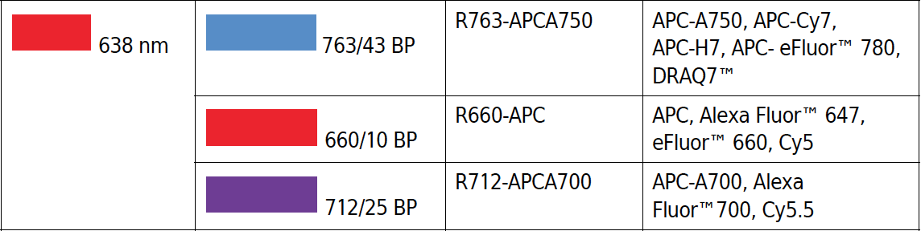
405/10 BP VioletSSC Alternative SSC
FSC
SSC
SSC-Violet
Other Filters:
• 405/10 BP
• 638/6 BP
• 561/6 BP
• 488/8 BP
Violet Yellow Red Blue

Slide 28
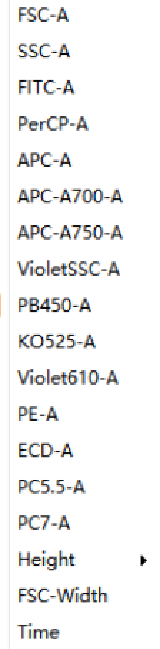
FSC
SSC
SSC-Violet
Other Filters:
• 405/10 BP
• 638/6 BP
• 561/6 BP
• 488/8 BP

Slide 29
Violet Yellow Red Blue

Slide 30
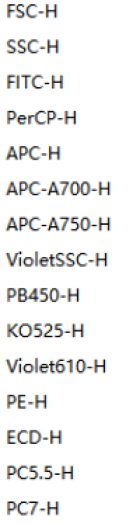
Violet Yellow Red Blue

