Slide 1

The Art of
Flow Cytometry
Sandra Hope, Ph.D.
Microbiology & Molecular Biology Department
College of Life Science
Brigham Young University

Slide 2
Flow Cytometry
The Flow cytometer
Selecting antibodies
Data interpretation
Control samples
Flow cytometry applications
Variations on a theme
Flow cytometry in the RIC
Notes:
Remember – mentored research as well as grad students here. Opportunities to do mentored research – student needs to do some hunting

Slide 3
Flow Cytometry

Slide 4
Hydrodynamic Focusing
Sample Core
Sheath Fluid
Sheath Fluid
Flow Cell

Slide 5
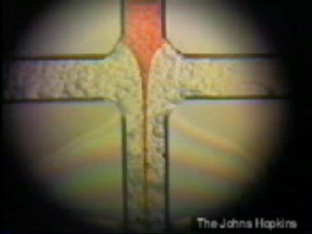
Hydrodynamic Focusing
Flow Cell

Slide 6
Hydrodynamic Focusing
Laser
readings

Slide 7


Flow Cytometry
Side
Scatter
Detector
(granularity)
LASER
Forward
Scatter
Detector
(size)

Slide 8
Flow Cytometry
Red Fluorescence
Detector
(protein expression)
LASER
Specific Antibody
with
Fluorescent Tag

Slide 9
Flow Cytometry
LASER

Slide 10
Flow Cytometry
Green
Detector
Red
Detector
Blue
Detector
Side
Scatter
Detector
(granularity)
LASER
Forward
Scatter
Detector
(size)

Slide 11
Flow Cytometry
Green
Detector
Red
Detector
Mirrors
Blue
Detector
Side
Scatter
Detector
(granularity)
LASER
Forward
Scatter
Detector
(size)

Slide 12
Fluorochrome Fluorescence
Emission
Wavelength
Laser light
Absorption
Wavelength
to PMT
Emission
Wavelength
Laser light
Absorption
Wavelength
to PMT

Slide 13
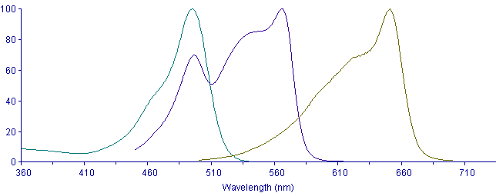
Absorption Wavelengths
FITC
PE
APC

Slide 14
Absorption Wavelengths
FITC
PE
APC
LASER
LASER

Slide 15
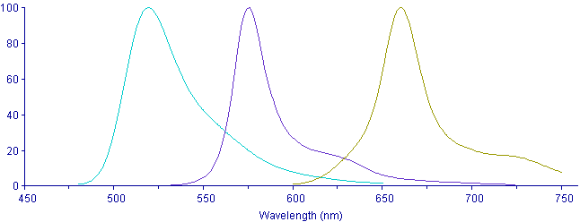
Emission Wavelengths
FITC
PE
APC

Slide 16
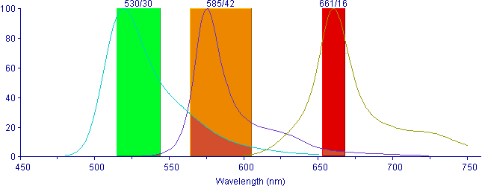
Emission Wavelengths
FITC
PE
APC

Slide 17
Flow Cytometry
Green
Detector
Red
Detector
Mirrors
Blue
Detector
Side
Scatter
Detector
(granularity)
LASER
Forward
Scatter
Detector
(size)

Slide 18
Flow Cytometry
Green
Detector
Red
Detector
Filters
Mirrors
Blue
Detector
Side
Scatter
Detector
(granularity)
LASER
Forward
Scatter
Detector
(size)

Slide 19
Emission Wavelengths
FITC
PE
APC

Slide 20
Antibody Selection
Excitation wavelength (laser compatibility)
  488 nm, 633 nm
Emission wavelength (detector compatibility)
  Can the RIC flow cytometer detect the color?
  RIC website, RIC technicians, Dr. Hope
Fluorochrome combinations
  Choose different colors!
  RIC website, RIC technicians, Dr. Hope
Notes:
check with RIC website
talk to Dr. Hope
talk to RIC lab technician

Slide 21
Antibody Selection
http://ricfacility.byu.edu → Equipment → FlowCytometers →
Fluorochromes Detectable by the Cytoflex
Laser | Fluorescent Channel | Channel Names/Dyes
488 nm - Blue | 525/40 | BL1, FITC, GFP, Alexa-488, CFSE, Fluo-3, YFP
 | 690/50 | BL2, PerCP, PI, PC5, PC5.5, PerCP-Cy5.5
 | 488/8 | Blue SSC
 | FSC | FSC
638 nm - Red | 780/60 | RL3, APC-H7, APC-A750, APC-Cy7, APC-eFluor780
 | 712/25 | RL2, APC-A700, Alexa-700
 | 660/20 | RL1, APC, Alexa-647, eFluor-660
561 nm - Yellow | 610/20 | YL2, ECD, mCherry, PI, PE-Texas Red, PE-CF594
 | 585/42 | YL1, PE, PI, dTomato, DsRed
 | 690/50 | YL3, PerCP, PI, PC5.5, PerCP-Cy5.5, PC5
 | 780/60 | YL4, PC7, PE-Cy7
405 nm- Violet | 405/10 | Violet SSC (nanoparticle)
 | 450/45 | VL1, Pacific Blue, Brilliant Violet 421, CFP, eFluor-450, V450
 | 525/40 | VL2, CFP-YFP, Krome Orange, AmCyan, V500, Brilliant Violet 510
 | 610/20 | VL3, mCherry, Brilliant Violet 605, Violet 610, Qdot 605
 | Other optional Filters | Optional Colors
 | 780/60 | For Violet laser
 | 660/20 | Brilliant Violet 650, Qdot 655
 | 561/10 | FSC, SSC for yellow laser
Laser | Fluorescent Channel | Channel Names/Dyes
488 nm - Blue | 533/30 | FL1, FITC, GFP, Alexa-488, SYBR Green, etc.
 | 585/40 | FL2, PE, PI, etc.
 | 670 Long Pass | FL3, PerCP-Cy5.5, PE-Cy7, mCherry, DsRed, etc.
640 nm - Red | 670 Long Pass | FL4, APC, Alexa-647, APC-Cy7, etc.
Accuri – Student Use
Cytoflex – Technician Use
Notes:
check with RIC website
talk to Dr. Hope
talk to RIC lab technician

Slide 22
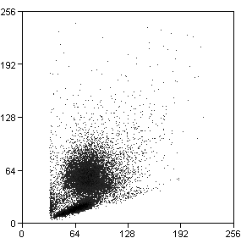
Flow Cytometry Data
SSC
FSC

Slide 23
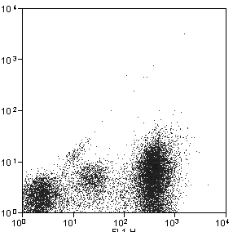
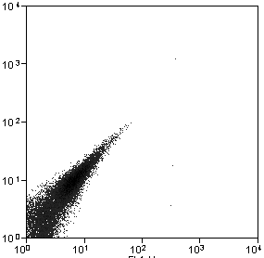
Flow Cytometry Data
PE
GFP
GFP

Slide 24
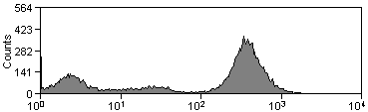
Flow Cytometry Data
Scatterplots
&
Histograms
PE
GFP
GFP

Slide 25
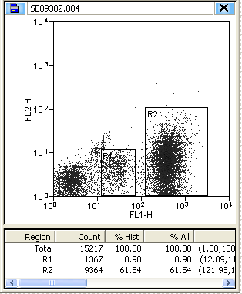
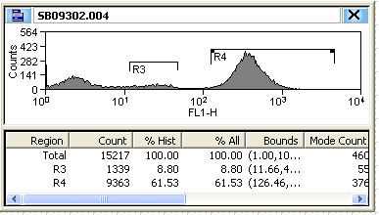
Flow Cytometry Data
Regions
PE
GFP
GFP

Slide 26
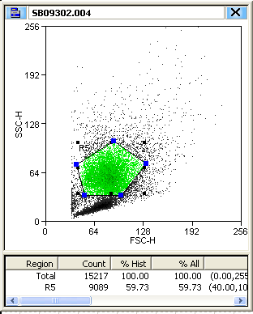
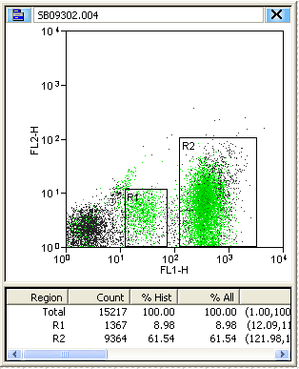
Flow Cytometry Data
Color Gates
SSC
FSC
GFP

Slide 27
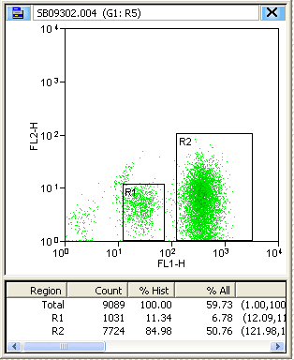
Flow Cytometry Data
Applying
a Gate to
another graph
SSC
FSC
GFP

Slide 28
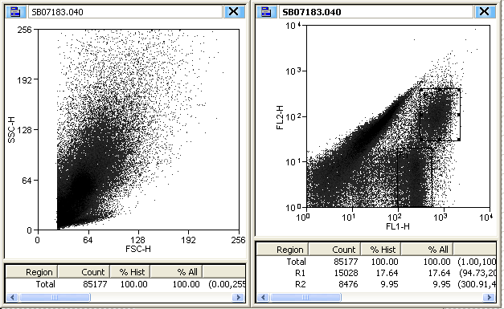
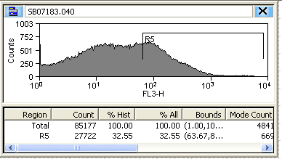
Flow Cytometry Data
Data Interpretation
- Identification of
populations

Slide 29
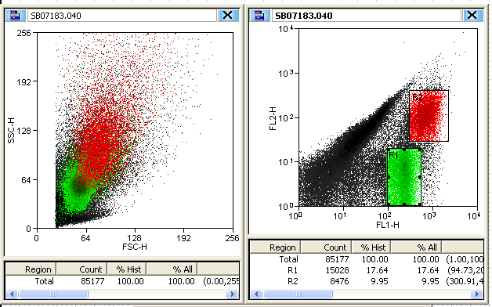
Flow Cytometry Data
Identification of
Populations
using color gates

Slide 30
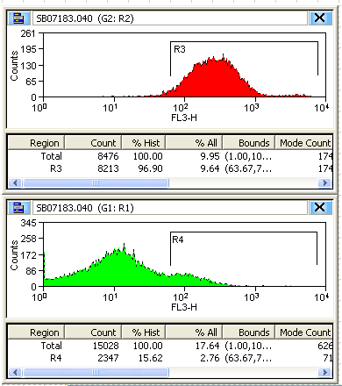
Multicolor Flow Cytometry
Identification of Populations
using applied gates

Slide 31
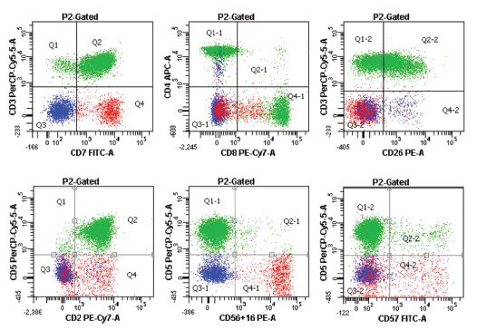
Multicolor Flow Cytometry
T cell Analysis – 6 colors
Immunophenotyping Utilizing 6 Color Flow Cytometry
2012,Ward Medical Laboratory, Volume 22, Number 3
http://www.wardelab.com/22-3.html

Slide 32

Fluorescence Intensity Settings
What does the technician do with your control samples?
Negative Control Sample
Cytoflex Cytometer
Negative Control Sample
with proper voltage settings on
the PMT detecting green
PMT
223
General light scatter
peak should be here
R1
Filter for
Green Fluorescence
167
111
Counts
55
0
General
light
scatter
10
0
10
1
10
2
10
3
10
4
Green Fluorescence
LASER

Slide 33
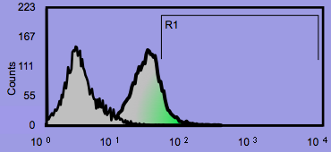
Fluorescence Intensity Settings
Negative Control Sample
Voltage
controls
sensitivity
Cytoflex Cytometer
Negative Control Sample
with voltage set too high
on PMT for green
PMT
223
Sample should
peak here
R1
Filter for
Green Fluorescence
167
111
Counts
55
0
General
light
scatter
10
0
10
1
10
2
10
3
10
4
Green Fluorescence
LASER

Slide 34
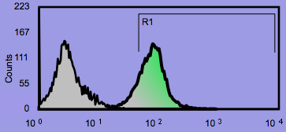
Fluorescence Intensity Settings
Negative Control Sample
Voltage
controls
sensitivity
Cytoflex Cytometer
Negative Control Sample
with voltage set extremely high
on PMT for green
PMT
223
Sample should
peak here
R1
Filter for
Green Fluorescence
167
111
Counts
55
0
General
light
scatter
10
0
10
1
10
2
10
3
10
4
Green Fluorescence
LASER

Slide 35
Fluorescence Intensity Settings
Single-Color Control Sample:
(check red sample for a red reading)
Cytoflex Cytometer
Positive Control Sample
with proper voltage settings on
the PMT detecting red
PMT
223
Any unstained cells
In the sample are
measured here
R1
Any cells stained with green-labelled antibody
are measured here
Filter for
Green Fluorescence
167
111
Counts
55
0
10
0
10
1
10
2
10
3
10
4
Red Fluorescence
LASER

Slide 36
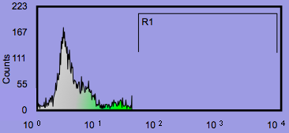
Fluorescence Overlap
Single-Color Control Sample:
(check red sample for a green reading)
Cytoflex Cytometer
A small amount of red can pass through the green filter
Red Control Sample (reading in green should be negative)
Some red fluorescence is able to
cross through the green filter
PMT
223
167
R1
Filter for
Green Fluorescence
111
Counts
55
0
10
0
10
1
10
2
10
3
10
4
Green Fluorescence
LASER

Slide 37
Fluorescence Overlap
FITC
PE
APC
Spectral Overlap

Slide 38
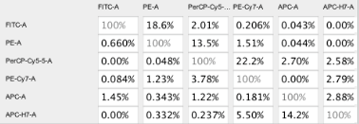
Compensation Matrix
For proper compensation matrix calculations,
each experiment needs:
  Negative control
  Single color positive controls = 1 for each color

Slide 39
Fluorescence Overlap
  Requires Compensation (digital threshold)
A small amount of red can pass through the green filter
Red Control Sample (reading in green should be negative)
Some red fluorescence is able to
cross through the green filter
PMT
223
167
R1
Filter for
Green Fluorescence
111
Counts
55
0
10
0
10
1
10
2
10
3
10
4
Green Fluorescence
LASER

Slide 40
Compensation subtracts false readings
A small amount of red can pass through the green filter
Red Control Sample (reading in green should be negative)
Instrument controls compensate for
“fluorescence overlap” of red
PMT
223
167
R1
Filter for
Green Fluorescence
111
Counts
55
0
10
0
10
1
10
2
10
3
10
4
Green Fluorescence
LASER

Slide 41
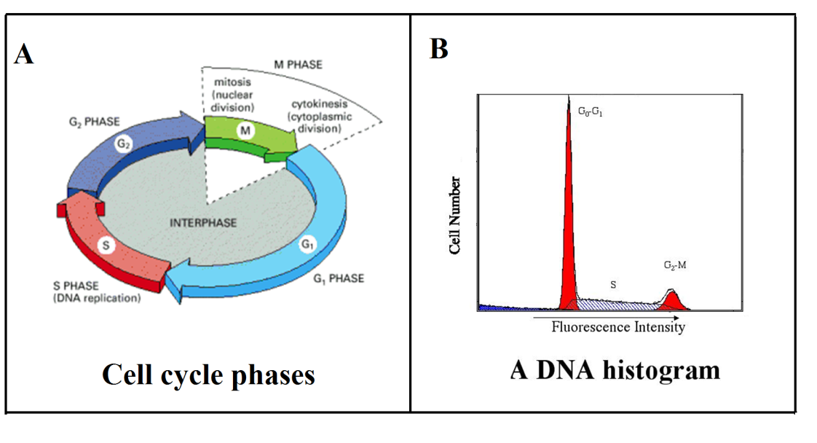
Flow Cytometry Applications
Propidium Iodide stains DNA

Slide 42
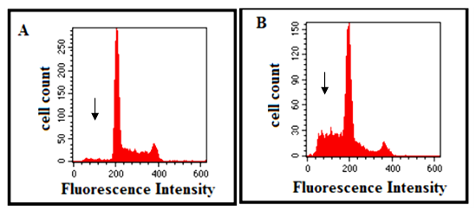
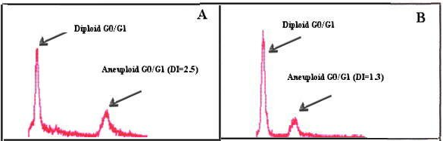
Flow Cytometry Applications
Cell Cycle
Division
Apoptosis
Nuclear DNA content

Slide 43
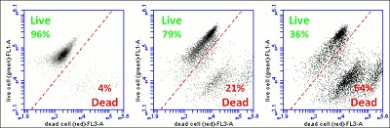
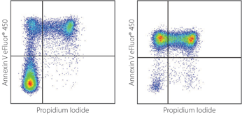
Flow Cytometry Applications
Cell Death
Live = esterase activity)
Dead = DNA binding
(compromised membranes)
Apoptosis = Annexin V
Dead = PI

Slide 44
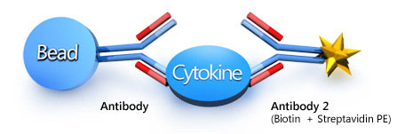
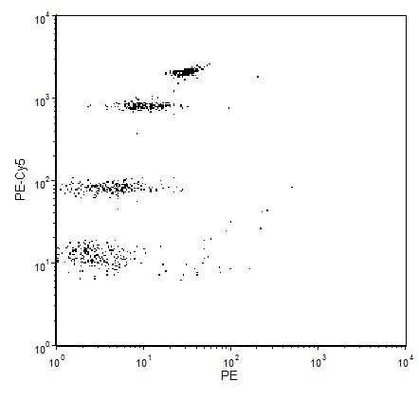
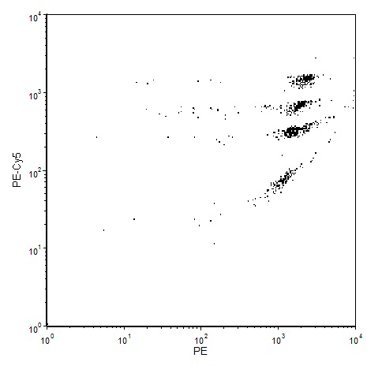
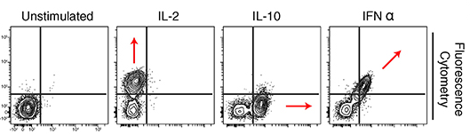
Flow Cytometry Applications
Detecting Proteins
in Supernatants
Negative control
Positive control
Cytokine panels
Beads
Phosphorylation
Cytokine Binding
pStat5
pStat3

Slide 45
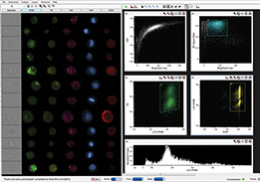
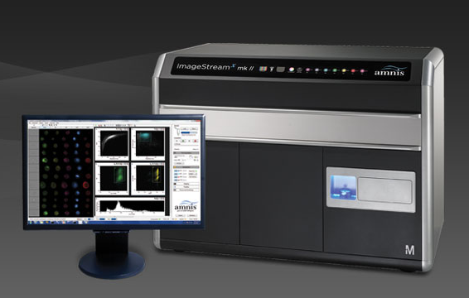
Variations on a Theme
Dark-field Microscopy
Camera
Amnis ImageStream
Imaging Cytometer

Slide 46
FACS
Fluorescence –
Activated
Cell Sorting
Variations on a Theme
Laser
to
PMT’s
Charge droplet
as it leaves
deflection
plate
+
-
deflection
plate
Sort 1
Waste
Sort 2

Slide 47
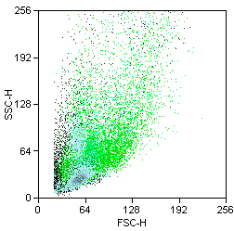
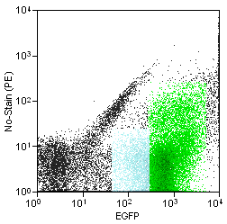
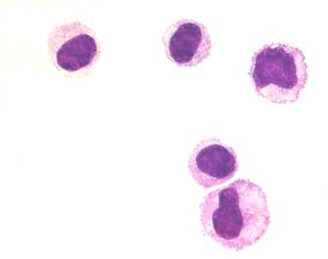
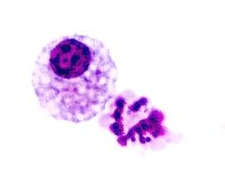
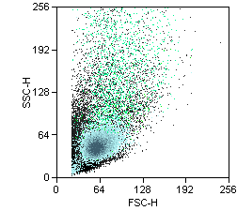
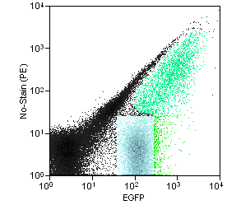
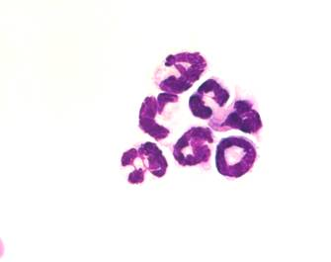
FACS Data
A
B
C
F
D
E
G

Slide 48
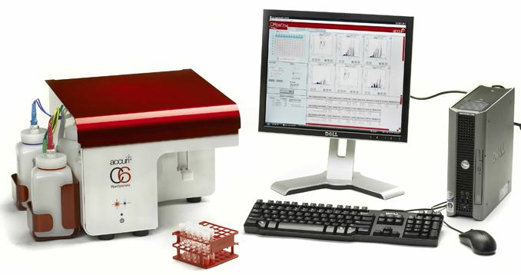
RIC Flow Cytometry Equipment
Cytoflex Flow Cytometer
4 laser, 13 color
Technician-run
Fall Semester Flow Class
Accuri Flow Cytometer
2 laser, 4 color
Fixed-voltage
Student-run

Slide 49

RIC Facility website http://ricfacility.byu.edu

Slide 50
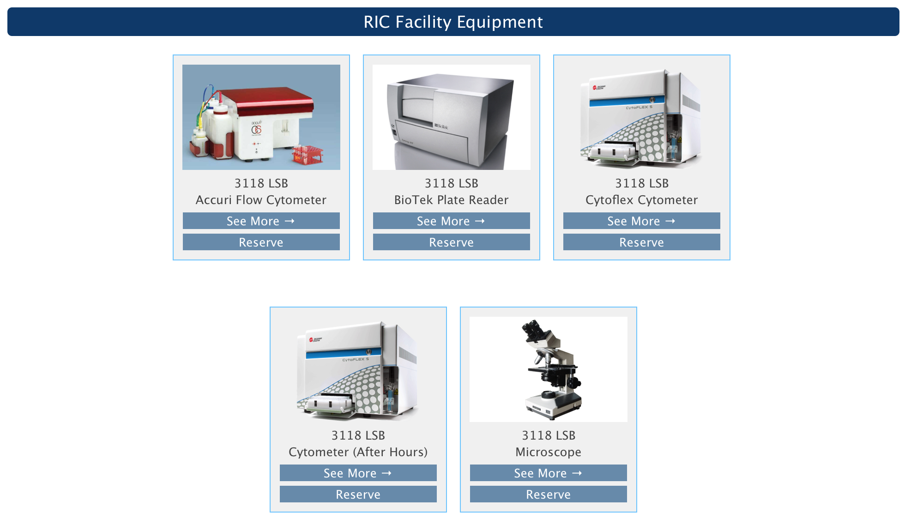
RIC Facility Scheduler

Slide 51
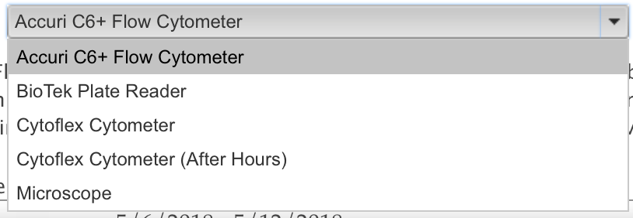
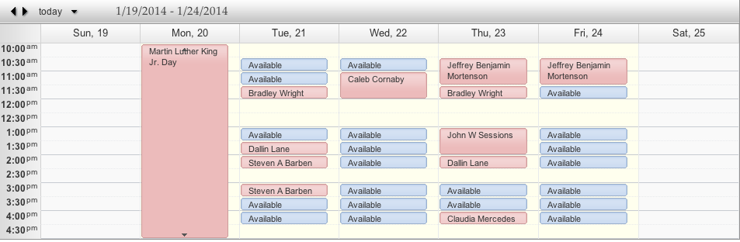
RIC Facility Scheduler http://ricfacility.byu.edu

Slide 52
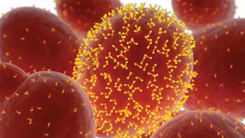
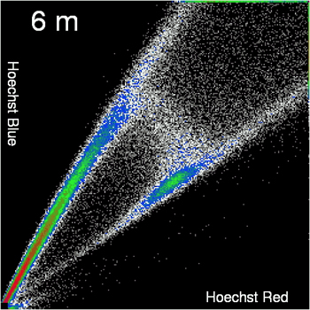
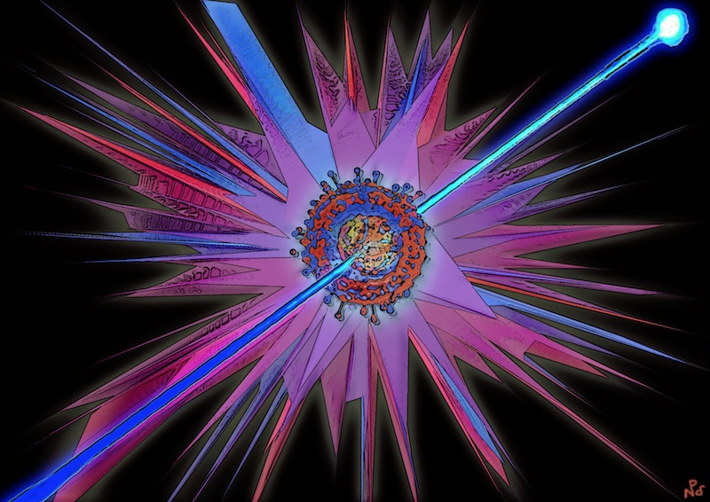
The Art of
Flow Cytometry

